Slide 1

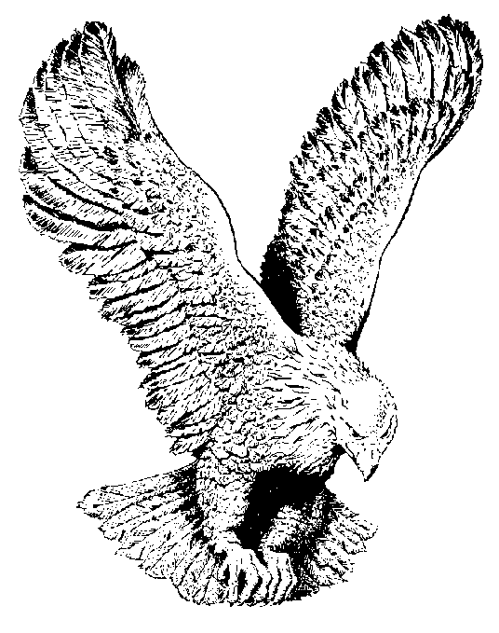
524 ONE MORE RIVER
I’ve had a lot of troubles and trials
In my little life time
When I’m standing alone
And the battle gets tough
I wanna do the best I can
Just to cross a million mountains
Shed a million tears
When I come to the river of Jordan
Hallelujah, then I’ll have no fear.

Slide 2
CHORUS
One more River to cross
One more Valley to climb
One more battle that I got to go through
Leaving my trouble behind
One more battle with the devil
And I know he’ll understand
I’m going through with Jesus
Hallelujah Holding to His nail scarred hands
Holding to His nail scarred hands.

Slide 3
Then a lot of people talk about me
Since I walk this narrow way
This is just to know I’m in the valley
Going up there, when I’m free
I’ve climbed a lot of high mountains
Crossed a lot of Red seas
When I sit on Jordan’s golden bank
That’ll be the last for me.

